Slide 1
Assignment-2
- Siva Prashanth B

Slide 2
Problem 1:
Decrypt the message using shift cipher technique.
WBISPJRLFJYFWAVZFZALT
Ans – PUBLICKEYCRYPTOSYSTEM. Key-7

Slide 3
Problem 2:
3.3 A cipher text has been generated with an affine cipher. The most frequent letter of the ciphertext is “B”. and the second most frequent letter of the ciphertext is “U”. Break this code.
Ans – one key for symmetric cipher. Two keys for asymmetric ciphers.
Assume that the most frequent plaintext letter is e and the second most frequent letter is t. Note that the numerical values are e = 4; B = 1; t = 19; U = 20. Then we have the following equations:
1 = (4a + b) mod 26 20 = (19a + b) mod 26
Thus, 19 = 15a mod 26. By trial and error, we solve: a = 3. Then 1 = (12 + b) mod 26. By observation, b = 15.

Slide 4
3.8 Ans - The Caesar cipher involves replacing each letter of the alphabet with the letter standing k places further down the alphabet, for k in the range 1 through 25.
SPUTNIK

Slide 5
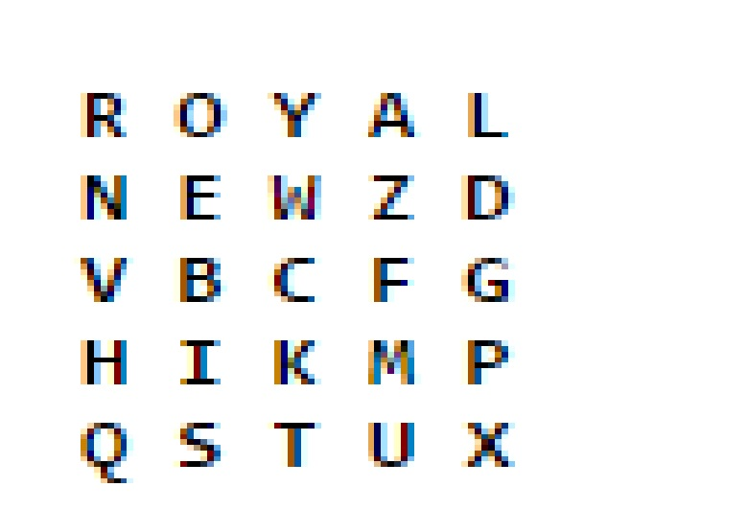
3.9 Ans - A monoalphabetic substitution cipher maps a plaintext alphabet to a ciphertext alphabet, so that each letter of the plaintext alphabet maps to a single unique letter of the ciphertext alphabet.
PT BOAT ONE OWE NINE LOST IN ACTION IN BLACKETT STRAIT TWO MILES SW MERESU COVE X CREW OF TWELVE X REQUEST ANY INFORMATION

Slide 6
3.19 Using the vigenere cipher encrypt the word “explanation” using the key “leg”.
Ans - key: legleglegle
plaintext: explanation
ciphertext: PBVWETLXOZR

Slide 7
6.4 What is the purpose of the state array?
Ans- The State array holds the intermediate results on the 128-bit block at each stage in the processing.

Slide 8
7.4 Ans - a. No. For example, suppose C1 is corrupted. The output block P3 depends only on the input blocks C2 and C3.
b. An error in P1 affects C1. But since C1 is input to the calculation of C2, C2 is affected. This effect carries through indefinitely, so that all ciphertext blocks are affected. However, at the receiving end, the decryption algorithm restores the correct plaintext for blocks except the one in error. You can show this by writing out the equations for the decryption. Therefore, the error only effects the corresponding decrypted plaintext block.

Slide 9
7.8 If a bit error occurs in the transmission of a ciphertext character in 8bit CFB mode. How far does the error propagate?
Ans - Nine plaintext characters are affected. The plaintext character corresponding to the ciphertext character is obviously altered. In addition, the altered ciphertext character enters the shift register and is not removed until the next eight characters are processed.

Slide 10
Thank You

